Slide 1

Excited States and Nonadiabatic Dynamics
CyberTraining School/Workshop 2022
Alexey Akimov
University at Buffalo, SUNY
July 4, 2022

Slide 2
General Workshop Goals
and
Overview of the CyberTraining Infrastructure

Slide 3

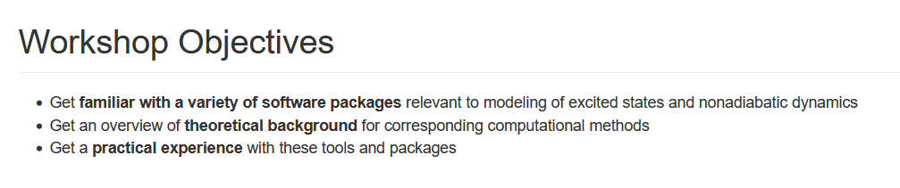
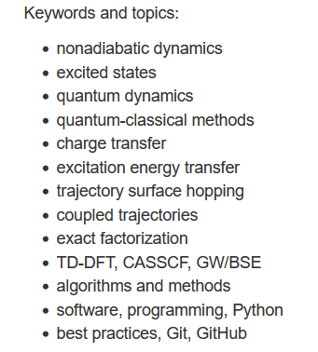
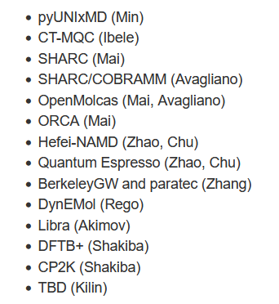
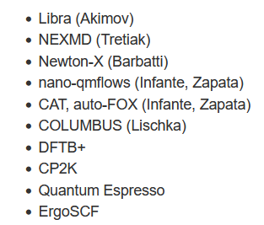
Objectives and Agenda
CyberTraining: Pilot: Modeling Excited State Dynamics in Solar Energy Materials
This year
Last year

Slide 4
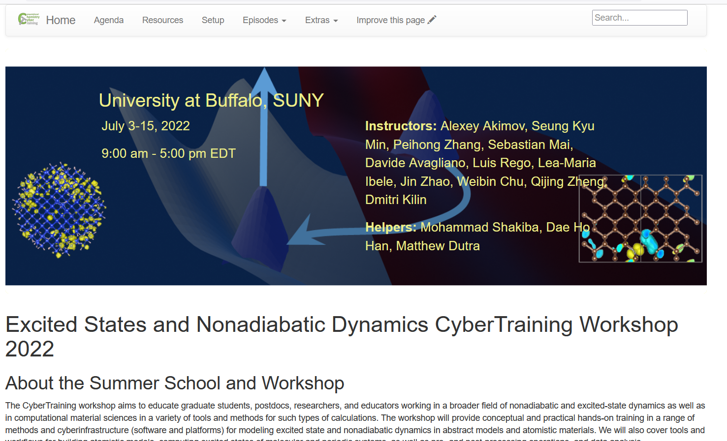
The Plan & Resources
All the details are here:
https://compchem-cybertraining.github.io/Cyber_Training_Workshop_2022/
Join Slack:
Members can invite new members
Private and public channels, direct (private) messages, conversations
Any time, but no strings attached
https://join.slack.com/t/quantumdynamicshub/shared_invite/zt-mjbhjssx-GGhsbYHxeBMvhmumK_j7LA
VPN and Accounts:
2-factor authentication
submit a ticket: https://ubccr.freshdesk.com/support/home

Slide 5
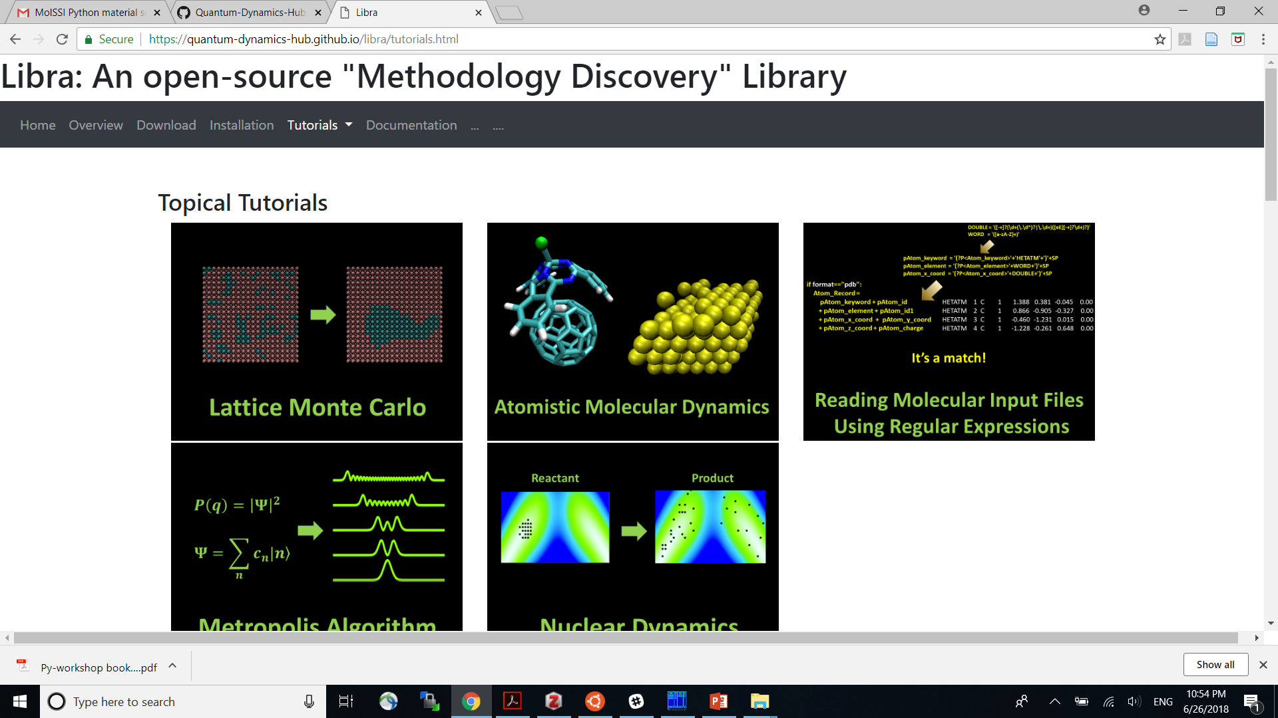
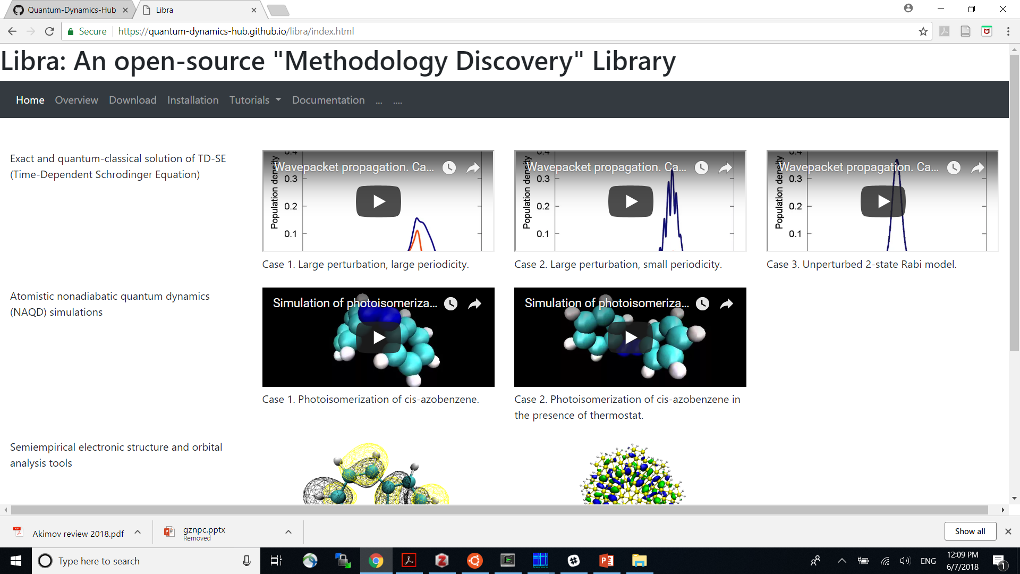
More Resources
Codes: https://github.com/Quantum-Dynamics-Hub
Training: https://github.com/compchem-cybertraining
Quantum Dynamics Hub
https://quantum-dynamics-hub.github.io/
CP2k (and CP2k/Libra) tutorials:
https://github.com/compchem-cybertraining/Tutorials_CP2K
we’ll be using them
Libra website: https://quantum-dynamics-hub.github.io/libra/index.html
Summer 2021 workshop:
https://compchem-cybertraining.github.io/Cyber_Training_Workshop_2021/
Winter school:
https://compchem-cybertraining.github.io/Libra_Winter_School_2022/
Libra tutorials:
https://github.com/compchem-cybertraining/Tutorials_Libra
Summer 2022 (This!) workshop:
https://compchem-cybertraining.github.io/Cyber_Training_Workshop_2022/

Slide 6
Daily Schedule
Daily
Breakfast = hotel
9:00 am – 12:00 pm: Morning session (Recording)
12:00 – 1:30 pm Working lunch/rest – on your own at “Commons”, rest, discuss, collaborate (No Recording)
1:30 pm – 5:00 pm: Afternoon session (Recording)
After 5:00 pm: collaborations/on your own, dinner on your own
Locations
Classes are @: July 4 – 7 Clemens 120; 8 July – Alumni Arena, Alumni 90, July 11-15 Talbert 107

Slide 7
Logistic
We cover your stay
Travel for the US participants, partially the international participants – we’ll need the paperwork
The forms will be distributed to you via Slack channel – please DON’t sent them back via e-mail
Stipends to cover the rest of expenses, please keep your receipts just in case.
We’ll need a confirmation that you aren’t getting reimbursements from your institutions.
A lot of paperwork later – likely it’ll be just me handling most of the stuff
Prizes: $300 (1 first prize), $200 (3 second prizes), $100 (5 first prizes) – the project competition. Online and in-person participants are eligible

Slide 8
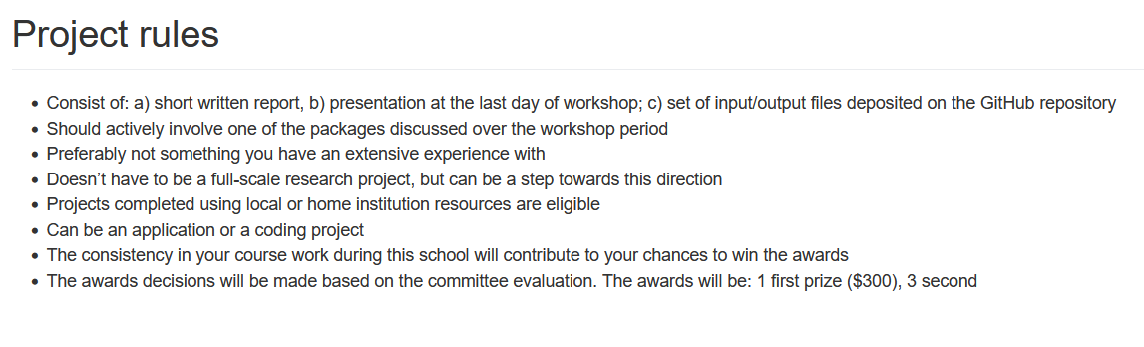
Project
Submit your project via GitHub by July 21
Oral presentation – tentatively July 22, via Zoom
Check out the past year projects:
https://github.com/compchem-cybertraining/Cyber_Training_Workshop_2021/tree/gh-pages/course_work
https://compchem-cybertraining.github.io/Cyber_Training_Workshop_2021/_episodes/13-projects

Slide 9
Now switch to Jeanette’s presentation

Slide 10
GitHub & Git
overview

Slide 11
Workflow
“fork”
Official Remote
“Upstream”
User Remote
”Upstream”
GitHub
Pull-request
git pull
git clone
git pull
git clone
git push
git push
git pull
git clone
Local Repo
“Downstream”
Local Repo
“Downstream”
Local Machine

Slide 12
Libra overview

Slide 13
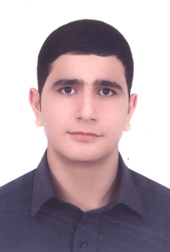
Instructors
Alexey Akimov
Mohammad Shakiba
Please Introduce Yourself
Name, position, affiliation, research group
Research interests and expertise
Anything else you would like to share with us

Slide 14


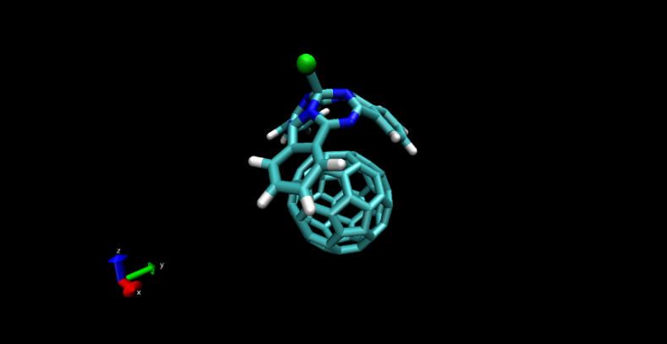
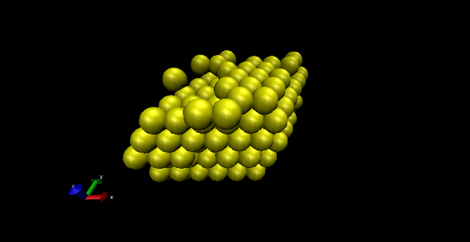
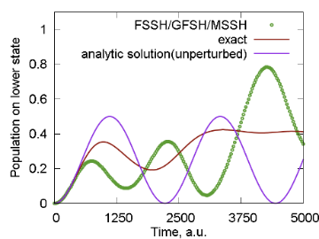
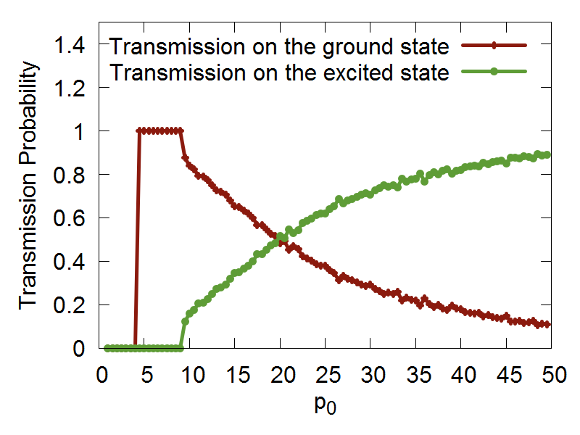
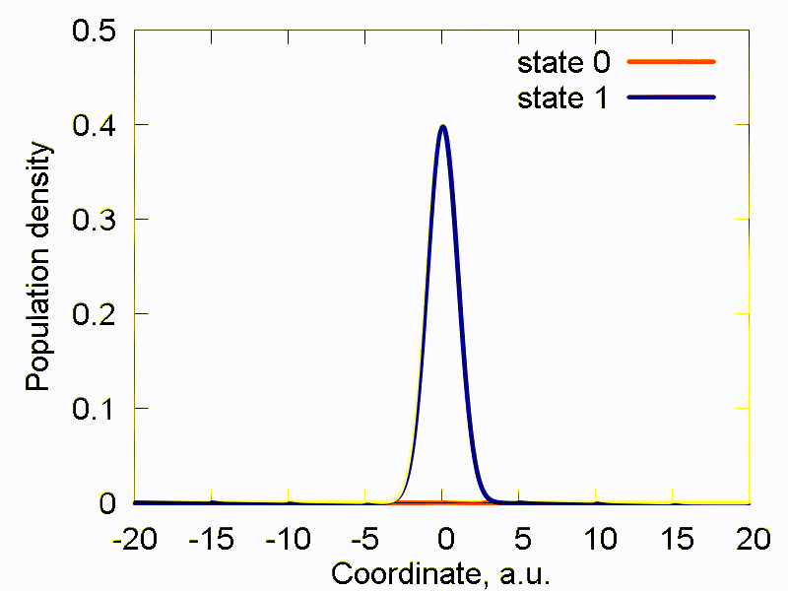
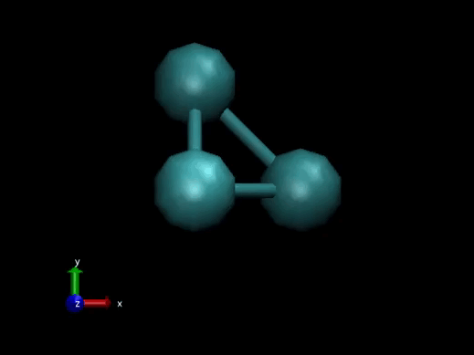
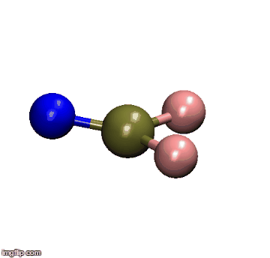
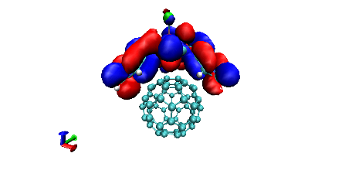
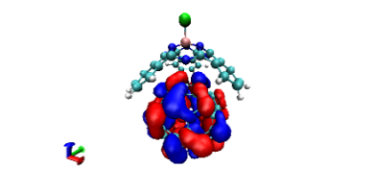
Libra History
Classical MD
Libra-X (with Drs. Ryoji Asahi, Kosuke Sato, Ekadashi Pradhan)
Sato, Pradhan, Asahi, Akimov PCCP 2018, 20, 25275
Pradhan, Sato, Akimov J. Phys.: Condens. Matter, 2018, 30, 484002
Interfaces with GAMESS, QE
Added back-reaction for QE
More modularization
Akimov, Prezhdo, JCTC, 2013, 9, 4959.
Akimov, Prezhdo, JCTC, 2014, 10, 789
Akimov JCC, 2016, 37, 1626
Ehrenfest & TSH
DVR
Back-reaction
Rigid body MD
Simplectic integrators for classical DOFs
Thermostats
Barostats
Force fields
ANN
Chemical object representation
Modularization and revision
DVR methods
Semiempirical Hamiltonians
Molecular integrals
Decoherence methods, TSH
Simplectic integrators for TDSE
TSH, Ehrenfest, stand-alone scripts
Decoherence methods
Model problems
Added HF and EHT to LCCCS
Interface with VASP, then QE
Pyxaid2 (with Prof. Wei Li)
Li, Zhou, Prezhdo, Akimov ACS Energy Lett, 2018, 3, 2159
SOC, multiple k-points, etc.
2007-2011
(LCCCS)
2011-2015
(Pyxaid)
2015/2016
(Libra)
2018
(Pyxaid2, Libra-X)

Slide 15
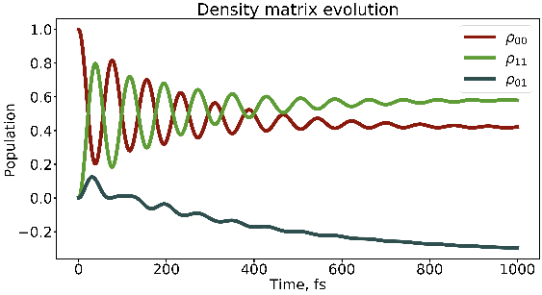
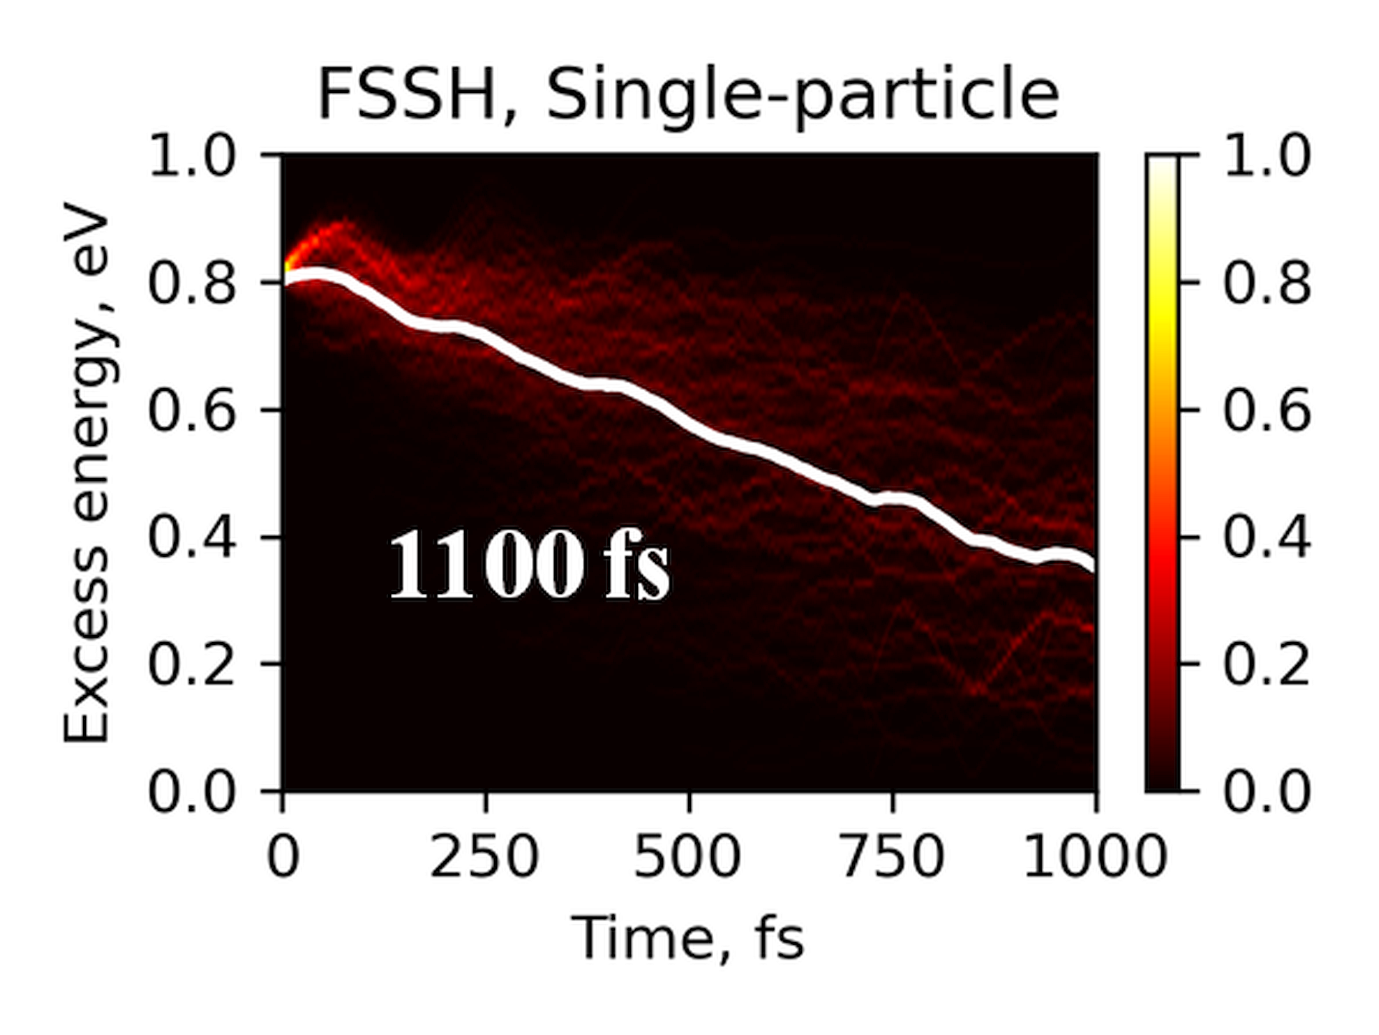
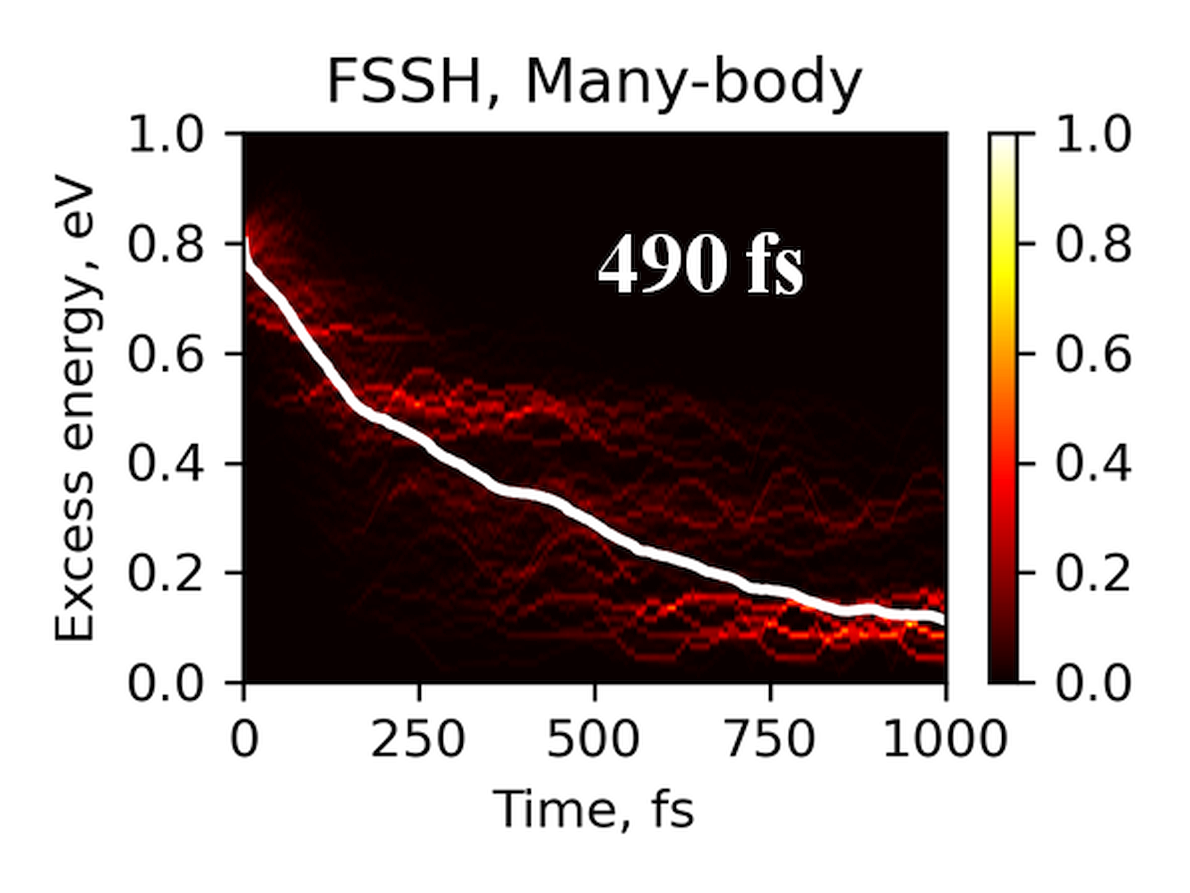
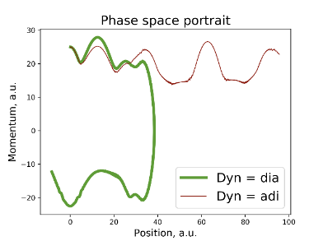
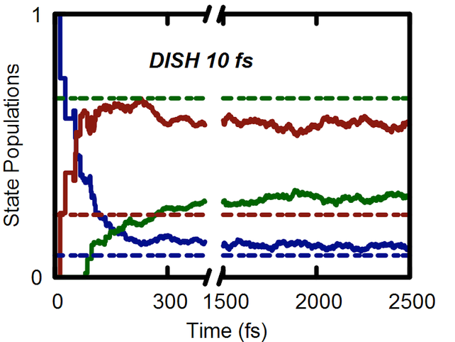
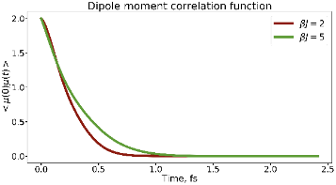
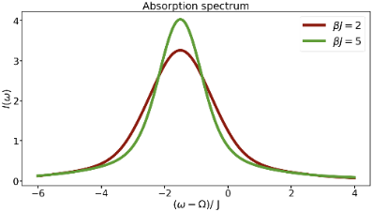
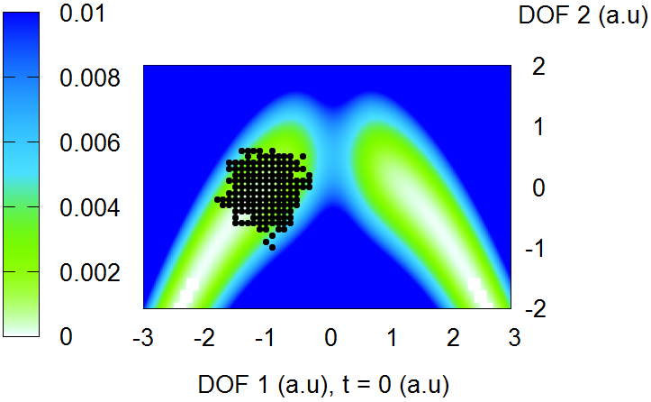
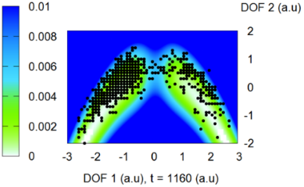
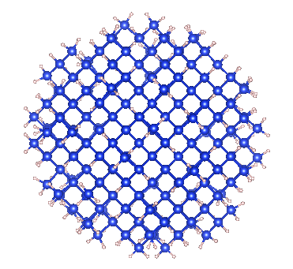
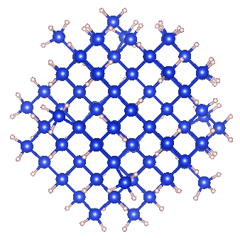
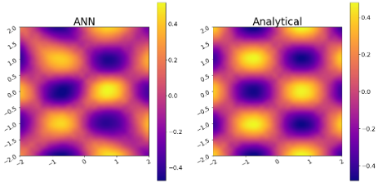
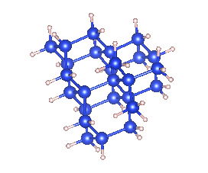
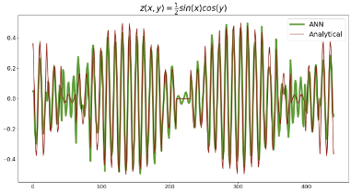
Libra History
Bastida’s Boltzmann-corrected Ehrenfest, mSDM
HEOM
Many-body NA-MD
Phase correction for NACs
Temen, Jain, Akimov Int. J. Quant. Chem., 2020, 120, e26373
Smith, B.; Shakiba, M.; AVA JCTC 2021, 17, 678
Smith, B.; Shakiba, M.; AVA JPCL 2021, 12, 2444
Akimov JPCL 2018 9, 6096-6102
Smith; Akimov JCP 2019, 151, 124107
Revised DISH, new workflows
Akimov JCP 2021, 155, 134106
Entangled trajectories
Smith, Akimov JCP 2018, 148, 144106
Belyaev-Lebedev LZ method
Machine Learning revised.
TD-ML approach
Smith, B.; Akimov, A. V JPCL 2020, 11, 1456-1465
Akimov JPCL 2021, 12, 12119
2018
2019
2020
2021

Slide 16
Libra Philosophy/Vision
modular
Maximize and simplify the re-use, OOP
linear algebra, integrals,
quantum and classical mechanics/dynamics,
nonadiabatic methods, surface hopping,
IO utilities, model preparation and analysis
versatile
“methodology discovery”
Use with model problems and atomistic simulations
Python – for convenience, C++ - for efficiency
(prototyping)
practical
Fully-functional tool that can be applied to real (atomistic) systems to study materials
user-friendly & documented
The code is convenient to users and they have plenty resources – examples and documentation
A platform to adopt the past and latest developments
The developers can understand and contribute to the code
community tool
Notes:
So that is what Libra is essentially about..
To give you a more practical idea of how these design principles are implemented, lets discuss several modules..

Slide 17
Libra motivation
Many codes (Newton-X, SHARC, NEXMD, FIERBALL, JADE, MOLPRO, PYXAID, PYUNIXMD, …)
Black-box. Difficult to re-use to formulate other methods, etc.
Limited functionality (high focus, e.g. atomistic of special kind)
Many methods (FSSH, DISH, A-FSSH, QTAG, QTSH, etc.)
Not always available
Not always user-friendly (e.g. my experience with PYXAID prototype)
Not always portable/modular, lack of best coding standards, no version control, etc.
Limited consistency of different codes
Possible redundancies even in the same code

Slide 18
Libra motivation
Adopt the best practices
Modularity (e.g. PySCF, Psi4NumPy, PyQuante, HORTON)
Language standards (Python, C++ vs. Fortran? Hybrid programming)
Testing & Documentations (pytest, unittest, Doxygen/Sphinx)
User/developer training (Workshops, Summer/Winter schools)
Focus on the community
Every group has expertise in their field – rely on that
Community contributions – PR on GitHub
Use version control and collaborative workflows via GitHub, Issues
Frequent communication and close collaboration e.g. via Slack

Slide 19
Community Tool: Code Contributions/Integration
Amber Jain – Hierarchical Equations of Motion (HEOM)
src/dyn/heom
https://github.com/amber-jain-group-iitb/heom_amber
Xiang Sun – (Non)-equilibrium Fermi Golden Rule (FGR)
src/fgr
https://github.com/tsiangsun/FGR
Nandini Ananth – Initial value representation (IVR)
src/ivr
https://github.com/AnanthGroup/SC-IVR-Code-Package
Sophya Garaschchuk – quantum trajectory guided Gaussians (QTAG)
in progress
Craig Martens – quantum trajectory surface hopping (QTSH)
in progress
… and more

Slide 20
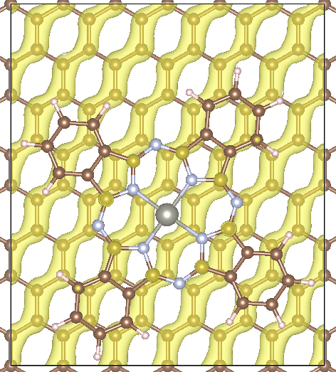
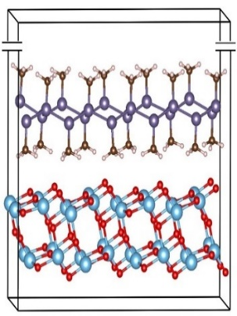
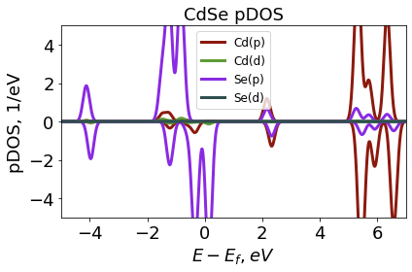
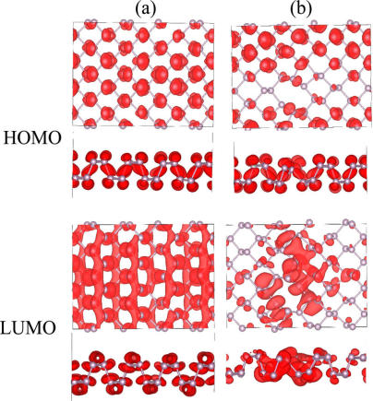
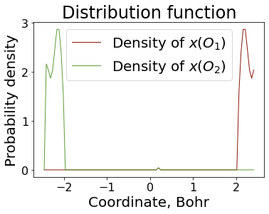
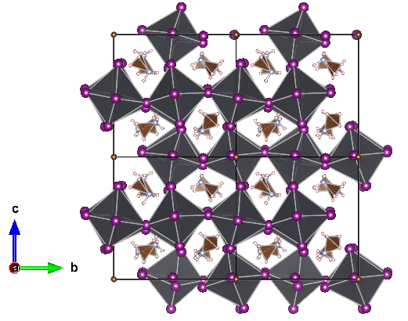
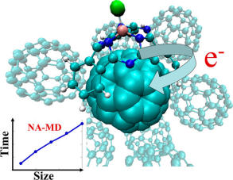
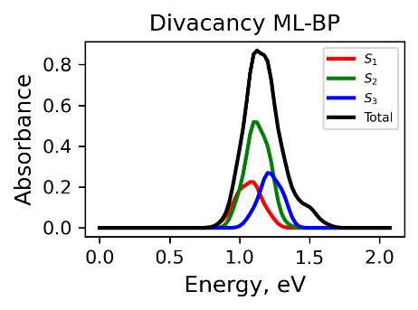
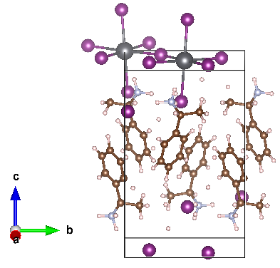
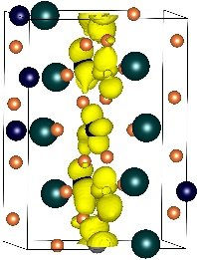
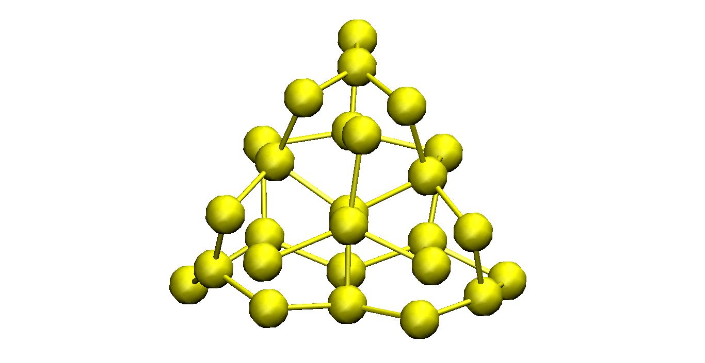
Practical: Libra in materials research
2D systems
2D heterojunctions
Auxiliary Analysis Tools
Long el al. JPCL 2016, 7, 653.
Nijamudheen, A.; AVA JPCC, 2017, 121, 6520
Perovskites
Quantum Dots & Molecules
Organic heterojunctions
Nijamudheen, A.; AVA JPCL 2018, 9, 248
Lin, Y.; AVA JPCA. 2016, 120, 9028
Sato et al. PCCP, 2018, 20, 25275.
Pradhan et al. JPCM, 2018, 30, 484002

Slide 21


C++/Python Interoperability
C++ layer
Python layer
User-Customized & Library
Python functions
Call by C++
Eigen 3
libra_py
Prototype and
Test (Discover)
Translate code
Use in C++ codes
Use in Python codes

Slide 22
Modularity: API Diversity
The goal is to suite the needs of the users of various levels
Find a balance between simplicity and flexibility
Developer/Efficiency
double gaussian_overlap( AO* AOa, AO* AOb,int is_normalize, int is_derivs, VECTOR& dIdA, VECTOR& dIdB, vector<double*>& auxd,int n_aux);
double gaussian_overlap( AO* AOa, AO* AOb,int is_normalize, int is_derivs, VECTOR& dIdA, VECTOR& dIdB );
double gaussian_overlap(AO* AOa, AO* AOb,int is_normalize);
double gaussian_overlap(AO* AOa, AO* AOb);
User/Convenience

Slide 23
Example
Computing kinetic energy between Gaussians
g1 = PrimitiveG()
g2 = PrimitiveG()
g1.init(n1,m1,k1, a1, VECTOR(x1, y1, z1))
g2.init(n2,m2,k2, a2, VECTOR(x2, y2, z1))
kin = kinetic_integral(g1,g2)
Benchmarked against PyQuante
p1 = PyQuante.PGBF.PGBF(a1,(R1.x,R1.y,R1.z),(n1,m1,k1))
p2 = PyQuante.PGBF.PGBF(a2,(R2.x,R2.y,R2.z),(n2,m2,k2))
val_ref = p1.kinetic(p2)

Slide 24

Passing Python functions
C++
Python
Models
Implementation
Interface

Slide 25
How it works with sampling
vector<MATRIX> metropolis_gau
(Random& rnd, bp::object target_distribution,
MATRIX& dof, bp::object distribution_params,
int sample_size, int start_sampling, double gau_var){
Metropolis Algorithm
double p_old =
bp::extract<double>( target_distribution(s_old, distribution_params) );
…
}
def test():
q = MATRIX(ndof, 1)
output = metropolis_gau( piab, q, params, ...)
User calls the sampling
Output
def piab(q, params):
User defines the
probability density
C++
Python

Slide 26
Example
q = MATRIX(1,1); q.set(0, 0.5)
params = {"k":1.0, "m":2000.0, "states":[0], "coeffs":[1.0]}
Nsamp = 1000000; Nstart = 50000
sampling = metropolis_gau(rnd, HO_sup, q, params, Nsamp,Nstart, 0.05)
bin(sampling, -1.5, 2.0, 0.01, 0, 0, "_distrib-1.txt")
User defines how to
run the MC sampling
def HO_sup(q, params):
k = params["k"]; m = params["m"];
states = params["states"]; coeffs = params["coeffs"]
x = q.get(0)
sz = len(states)
p = 0.0
for n in xrange(sz):
p = p + coeffs[n] * ket_n(x, states[n], k, m)
p = p * p
return p
User defines what
probability distribution
function is to be sampled
The dynamical algorithm is in C++, but…
Don’t need to implement the model in C++

Slide 27
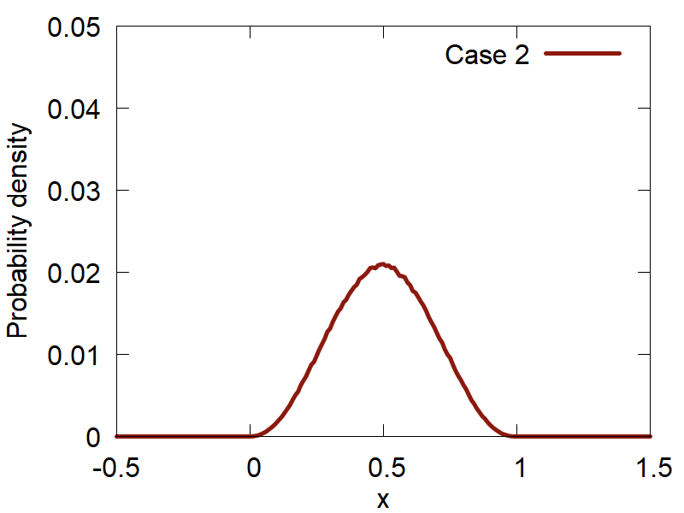
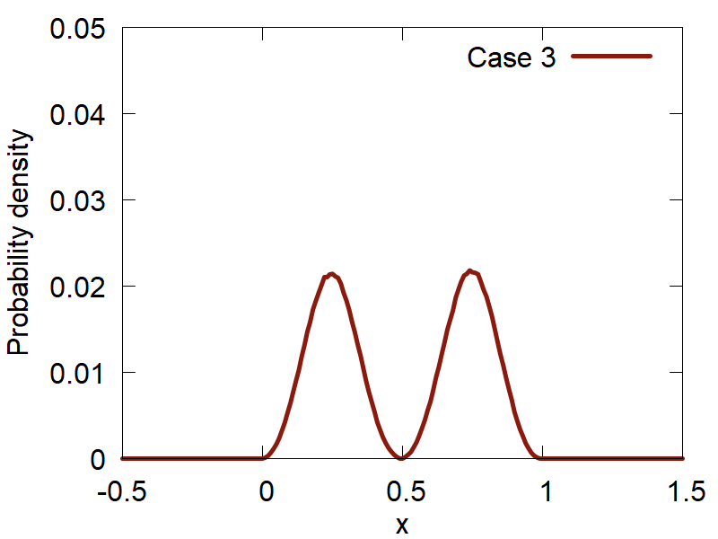
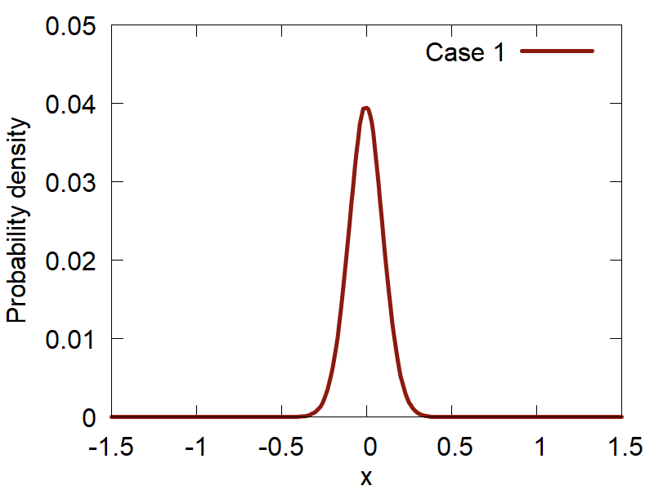
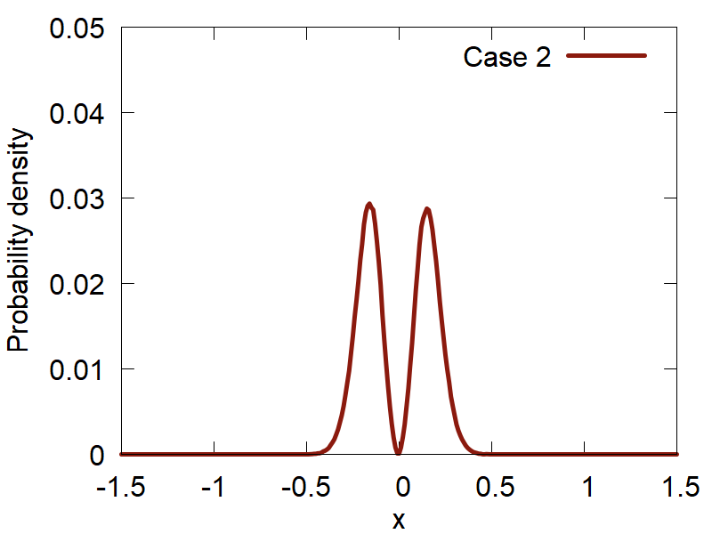
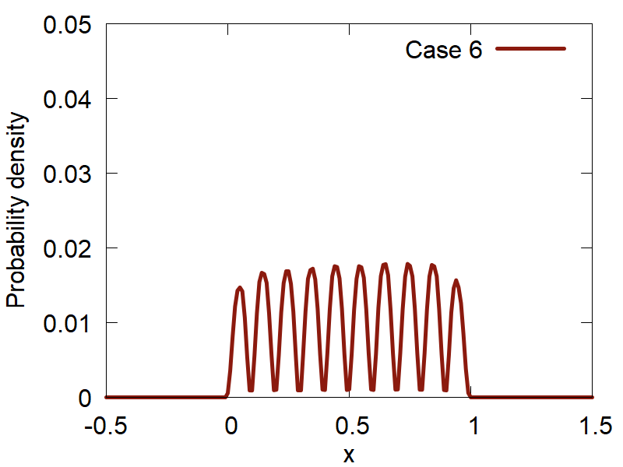
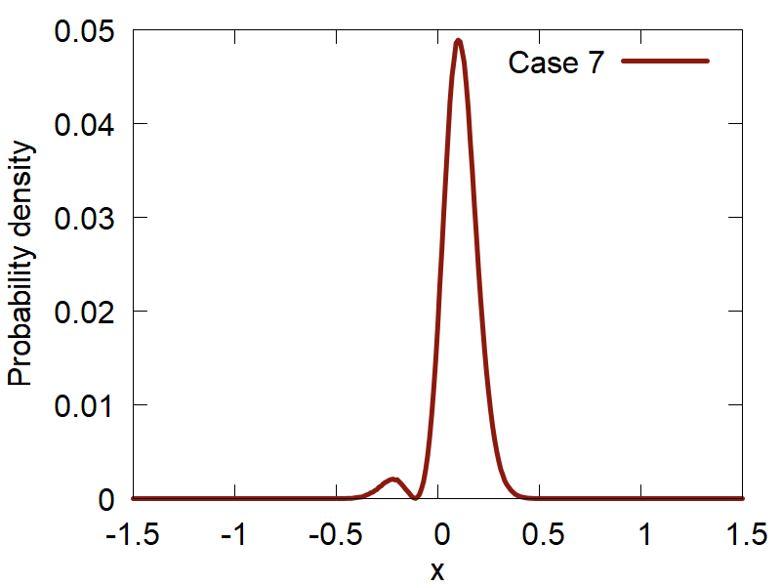
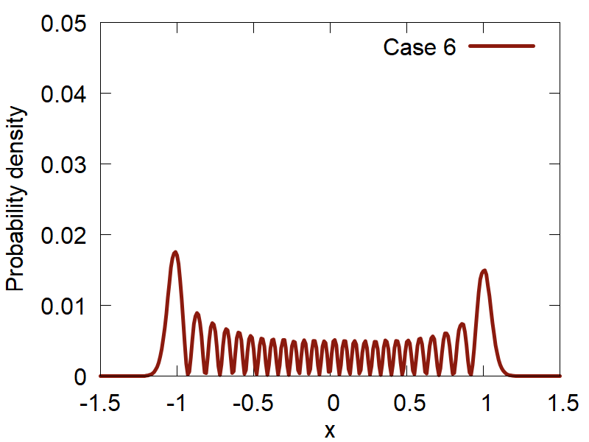











Initial conditions: Metropolis Sampling
Particle in a box
Harmonic oscillator
$$ψ_{n}\left(q\right)\sim \sin\left(\frac{πnq}{L}\right)$$
$$ψ_{n}\left(q\right)\sim H_{n}\left(q\sqrt{α}\right)\exp\left(−\frac{αq^{2}}{2}\right)$$
$$\left.|1\right\rangle$$
$$\left.|2\right\rangle$$
$$\left.|1\right\rangle$$
$$\left.|0\right\rangle$$
$$\left.|10\right\rangle$$
$$\left.|0\right\rangle +\left.|1\right\rangle$$
$$\left.|25\right\rangle$$
$$\left.|0\right\rangle −\left.|1\right\rangle$$

Slide 28


How it works with dynamics
C++
Python
Transformations
User-defined
Hamiltonian
Ham_adi
Ham_dia
d1Ham_adi
d1Ham_dia
…
…
Dynamical Algorithm
$$q←q+\frac{p}{m}dt$$
User calls dynamics
ham.compute_diabatic(bp::object py_funct, bp::object q, bp::object params)
ham.compute_adiabatic(int lvl)
Output
$$p←p+f\frac{dt}{2}$$

Slide 29
Keep Dynamical Workflow Fixed
User defines how to
run the dynamical simulation
for i in xrange(500):
propagate_el(Cdia, Cadi, Hvib, Sdia, 0.5*dt, rep)
p = p + 0.5*f*dt
q = q + dt*p/m
compute_model(model, Hdia, Sdia, d1ham_dia, dc1_dia, q, params)
ham.compute_adiabatic(1);
f = compute_frc(ham, Cdia, Cadi, rep)
p = p + 0.5*f*dt
Hvib = compute_Hvib(Hdia, Hadi, dc1_dia, dc1_adi, p, m, rep)
propagate_el(Cdia, Cadi, Hvib, Sdia, 0.5*dt, rep)
Etot = compute_etot(ham, p, Cdia, Cadi, m, rep)
User defines what function to use to compute entries in the
Hamiltonian object (diabatic/adiabatic Ham, overlap matrix, derivatives, etc.) - NEXT

Slide 30
Example: Model Calculations
def model2(q, params):
obj = tmp()
obj.ham_dia = CMATRIX(2,2); obj.ovlp_dia = CMATRIX(2,2);
obj.d1ham_dia = CMATRIXList(); obj.d1ham_dia.append( CMATRIX(2,2))
obj.dc1_dia = CMATRIXList(); obj.dc1_dia.append( CMATRIX(2,2))
x = q.get(0)
x0,k,D,V = params["x0"], params["k"], params["D"], params["V"]
obj.ovlp_dia.set(0,0, 1.0+0.0j); obj.ovlp_dia.set(0,1, 0.0+0.0j);
obj.ovlp_dia.set(1,0, 0.0+0.0j); obj.ovlp_dia.set(1,1, 1.0+0.0j);
obj.ham_dia.set(0,0, k*x*x*(1.0+0.0j) ); obj.ham_dia.set(0,1, V*(1.0+0.0j));
obj.ham_dia.set(1,0, V*(1.0+0.0j)); obj.ham_dia.set(1,1, (k*(x-x0)**2 + D)*(1.0+0.0j));
for i in [0]:
obj.d1ham_dia[i].set(0,0, 2.0*k*x*(1.0+0.0j) ); obj.d1ham_dia[i].set(0,1, 0.0+0.0j);
obj.d1ham_dia[i].set(1,0, 0.0+0.0j); obj.d1ham_dia[i].set(1,1,2.0*k*(x-x0)*(1.0+0.0j));
obj.dc1_dia[i].set(0,0, 0.0+0.0j); obj.dc1_dia[i].set(0,1,-0.1+0.0j);
obj.dc1_dia[i].set(1,0, 0.1+0.0j); obj.dc1_dia[i].set(1,1, 0.0+0.0j);
return obj
Initialize Python objects
Set matrix elements according to
your model

Slide 31
Example: Atomistic Calculations
def model_atomistic(q, params, indx):
natoms = params["natoms"]; ndof = q.num_of_rows; ndia = params[ "ndia" ]
params[ "output_filename" ] = "detailed.out“
obj = tmp()
obj.ham_dia = CMATRIX(1,1);
obj.ovlp_dia = CMATRIX(1,1); obj.ovlp_dia.set(0,0, 1.0+0.0j)
obj.d1ham_dia = CMATRIXList();
for i in xrange(ndof):
obj.d1ham_dia.append( CMATRIX(1,1) )
os.system("mkdir wd/job_"+str(indx))
os.system("cp dftb_in.hsd wd/job_"+str(indx)) #+"/dftb_in.hsd")
os.chdir("wd/job_"+str(indx))
create_input.update_coordinates(q, params)
os.system("srun %s < dftb_in.hsd > out" % (exe_name) ) # DFTB calculations are run here!
dftb_forces = parse_output.get_forces(params)
os.chdir("../../")
for i in xrange(ndof):
obj.d1ham_dia[i].set(0,0, dftb_forces[i]*(-1.0+0.0j) )
obj.dc1_dia[i].set(0, 0, 0.0+0.0j)
return obj
Initialize Python objects
Prepare and Run external program
Set matrix elements according to
your model

Slide 32
Why contribute?
Make your methods broadly available (mutually advertise)
Be listed on the developers/contributors lists, get credentials, get citations
Make your methods compatible with other methods, enable easier interfacing – this facilitates new methods developments
Take advantage of other methods/functions/data types available in the same code – learn once then swim
Take advantage of improvements of other parts of the code
Mutually ensure best standards and facilitate bug discovery/testing

Slide 33

How to contribute?
https://github.com/amber-jain-group-iitb/heom_amber
Before:
hard-coded inputs (recompile for all parameters)
Fortran into executable
After:
General-purpose code, any inputs
Python/C++, integrate with the plotting scripts, etc.
create a pull-request
open an issue
start a discussion (haven’t tried yet)

